Slide 1
Analysis of City of Seattle Collision Data
Data 5100
Group 5: Ava Delanty, Lizz Hunt, Akanksha Sharma, Anna Tsai

Slide 2
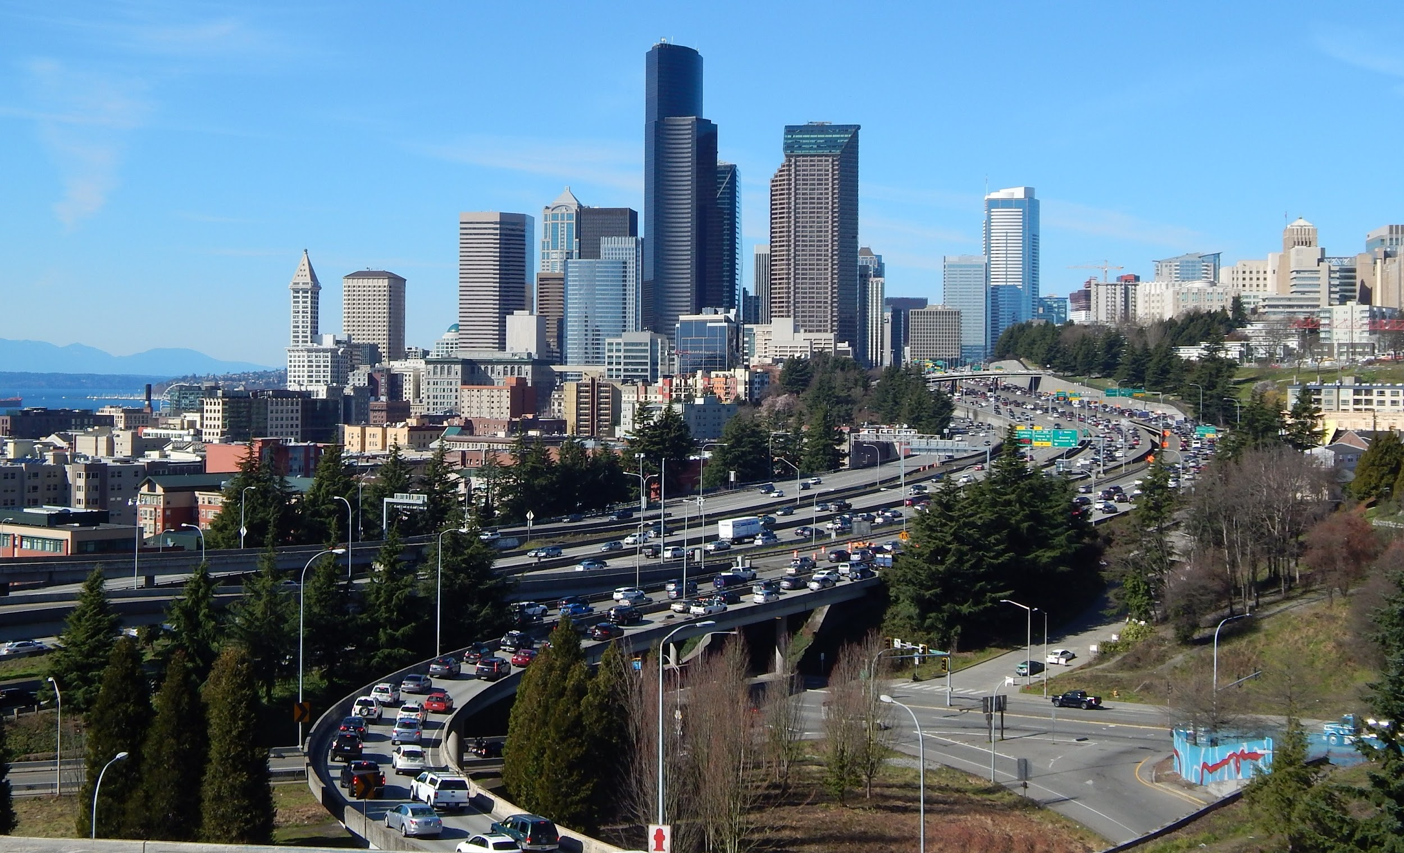
Introduction
In Seattle, traffic deaths or injuries have continued to rise.
Speed limits and speeding are one of the leading factors in the severity of collisions (City of Seattle).
Understanding the bigger picture.
This project will use the City of Seattle’s collision dataset to analyze these different factors.
Notes:
The presentation contains an introduction that describes the problem to an unfamiliar audience. The question(s) addressed in the project are clearly understandable from the introduction.

Slide 3
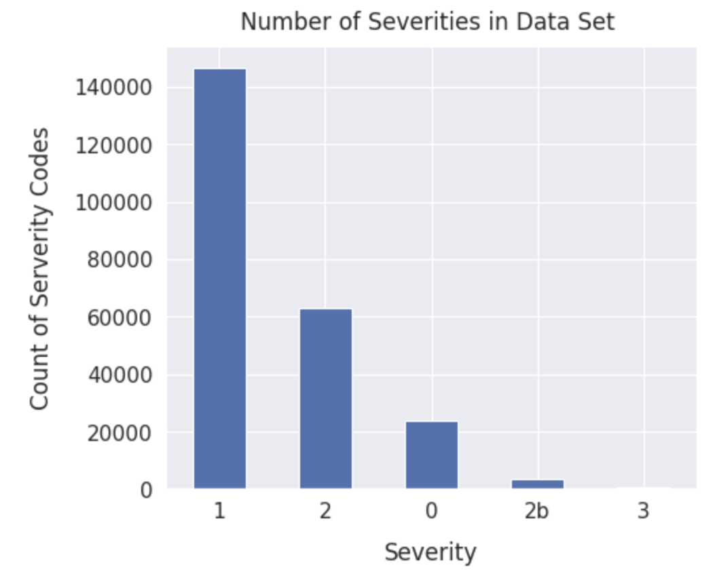
Data Description
The dataset includes all types of collisions from 2004 to Present day.
The size of our dataset is 9,487,040 elements (237,176 rows).
The dataset is from the City of Seattle Gov. site and is collected by the SDOT Traffic Management Division.
Quality of the Data: NaNs.
Data Processed: Extracting the csv file from site.
Unsure on whether informed consent was given for data collection.
No privacy was violated.
Notes:
The presentation describes the data used in the project. The description includes: 1. The type of the data used (e.g. images, medical records). 2. The size of the data set. 3. The source of the data and how the data were collected. 4. A discussion of the quality of the data. 5. How the data were processed. 6. Whether informed consent was given by subjects (if applicable). 7. How privacy is maintained for the subjects (if applicable).
There is no Personal identified information

Slide 4
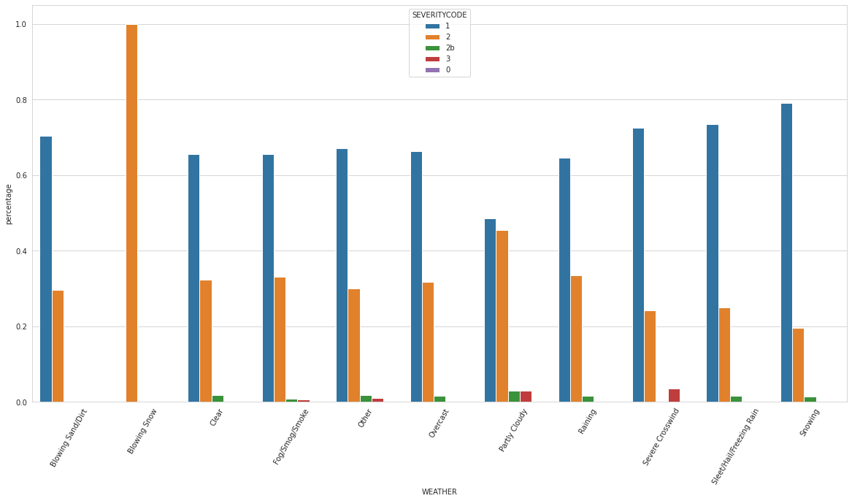
Exploratory Data Analysis: Weather

Slide 5
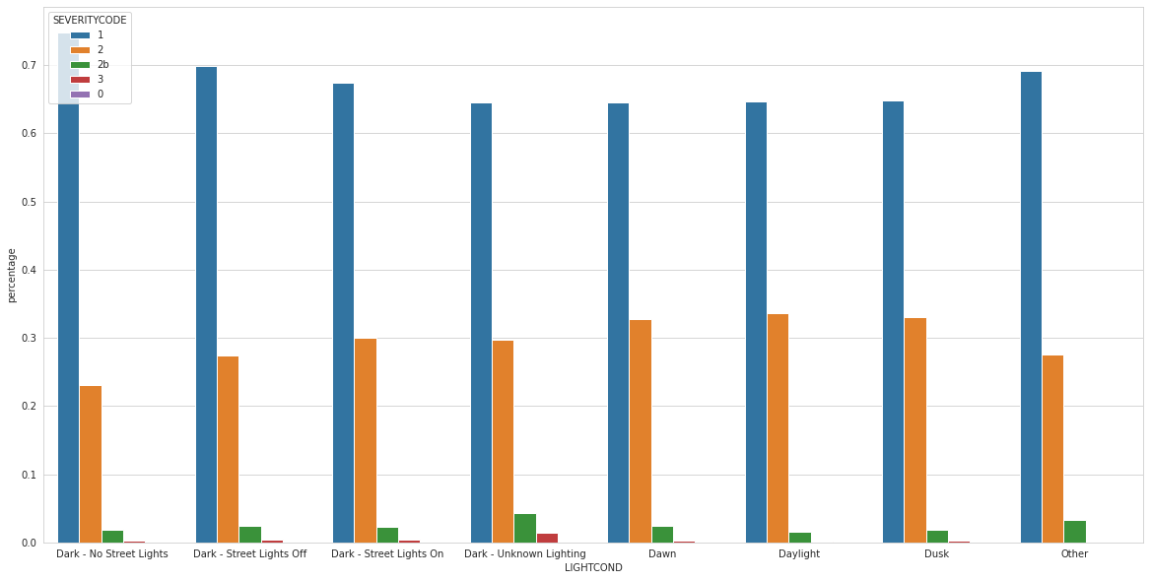
Exploratory Data Analysis: Light condition

Slide 6
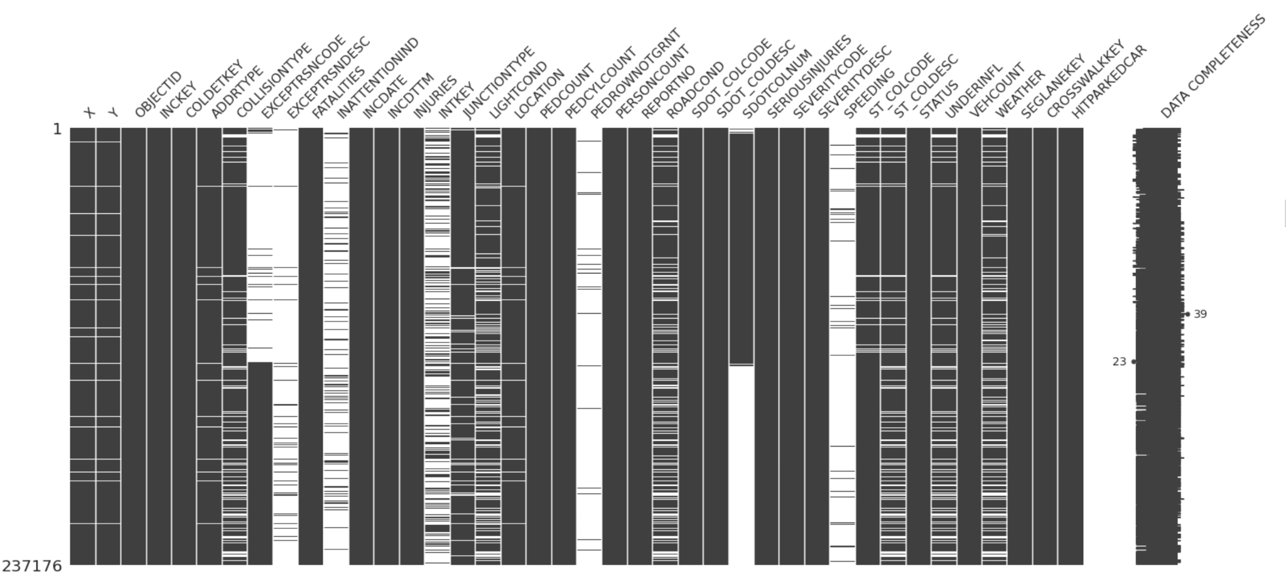
Data Preparation and Initial Analysis
Handling missing values
Imputation:
Missing Values
Hit Parked
Speeding
Under Influence of drugs

Slide 7
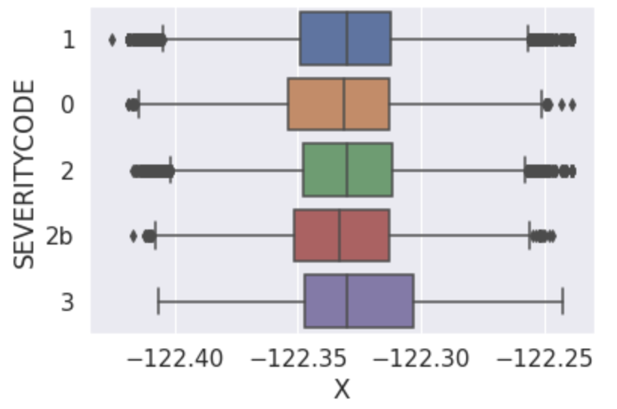
Data Cleaning
Columns we removed from the dataset:
Latitude and Longitude
Fatalities
Serious Injuries
Injuries
One hot encoding for the categorical variables

Slide 8
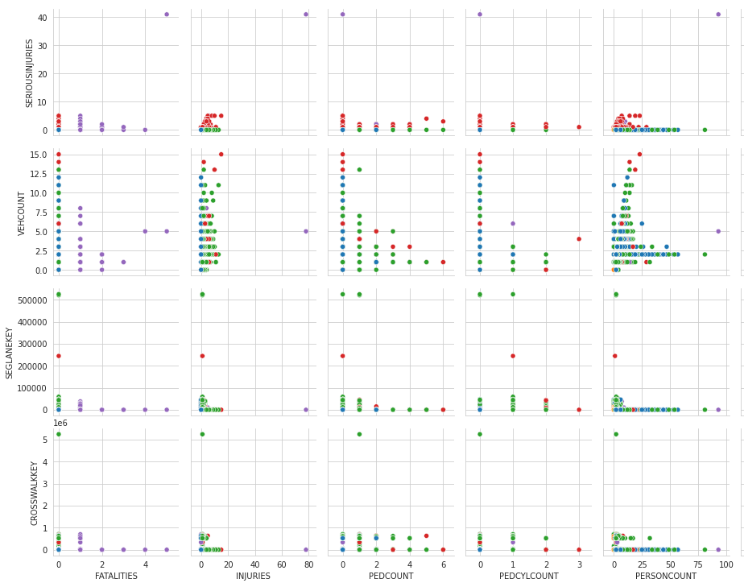
Pair Plot
Image shows a subset of the pair plot, hue is severity code
Can see a lack of defined clusters, data looks almost categorical

Slide 9
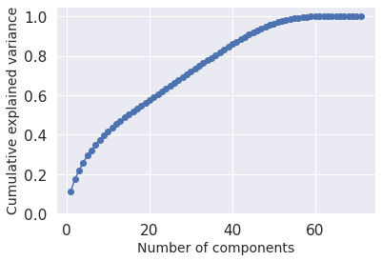
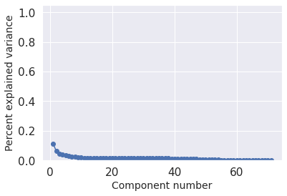
Principal Component Analysis
Notes:
Need 45 components for 90% variability

Slide 10
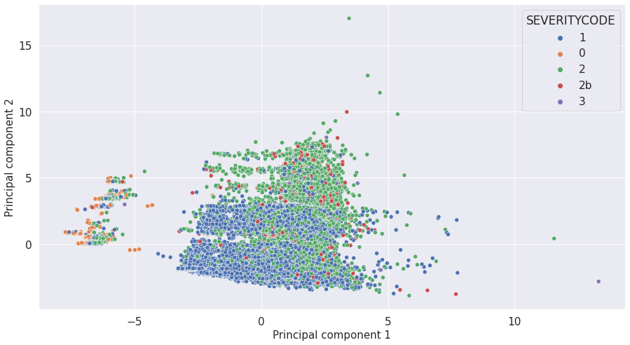
Principal Component Analysis (cont.)

Slide 11
Modeling Approach
20 predictors after data cleaning
Response: Severity Code (5 categories)
Type of problem
Supervised Classification problem
Logistic Regression
L1 Regularization
Random Forest Tree
Hypertuning based on number of parameters
Notes:
ADDRTYPE, COLLISIONTYPE, CROSSWALKKEY, INATTENTIONIND', 'INCDTTM’ 'JUNCTIONTYPE, 'LIGHTCOND, PEDCOUNT', 'PEDCYLCOUNT', 'PEDROWNOTGRNT', 'PERSONCOUNT', 'ROADCOND 'SDOT_COLCODE', 'SEGLANEKEY', 'SEVERITYCODE', 'SPEEDING', STATUS'ST_COLCODE', 'UNDERINFL','VEHCOUNT', 'WEATHER

Slide 12
Modeling Results–Logistic Regression vs Random Forest
Model | Accuracy | Specificity | Sensitivity
Logistic Regression | 75% | 0.994 | 0.934
Random Forest | 75% | 0.973 | 0.974
Notes:
We can see that the Random Forrest and Logistic Regression Models

Slide 13
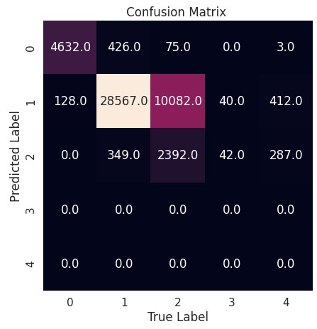
Random Forest Performance
 | Precision | Recall | F1-Score | Support
0 | 0.9 | 0.97 | 0.94 | 4,760
1 | 0.73 | 0.97 | 0.83 | 29,342
2 | 0.78 | 0.19 | 0.31 | 12,549
2b | 0 | 0 | 0 | 702
3 | 0 | 0 | 0 | 82

Slide 14
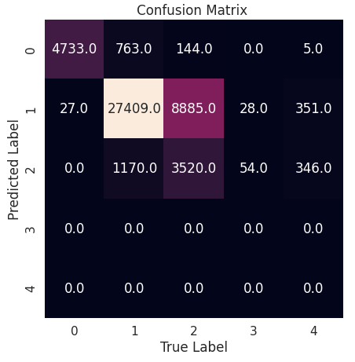
Logistic Regression Performance
 | Precision | Recall | f1-score | Support
0 | 0.84 | 0.99 | 0.91 | 4,760
1 | 0.75 | 0.93 | 0.83 | 29,342
2 | 0.69 | 0.28 | 0.40 | 12,549
2b | 0 | 0 | 0 | 702
3 | 0 | 0 | 0 | 82

Slide 15
Logistic Regression Model Sensitivity
Predicting Property Damage
Parameter | Sensitivity
Pedestrian count | -2.95
Cyclist Ped Count | -2.248
Weather Blowing Snow | -1.48
Collision Type Parked Car | +2.51
Collision type Sideswipe | +1.621181
Predicting Injuries
Parameter | Sensitivity
Collision Type Parked Car | -1.84
Collision Type Sideswipe | -1.13
Collision Type Cycles | +1.112
Collision Type Pedestrian | +1.102
Predicting Unknown Severity
Parameter | Sensitivity
Person Count | -2.51
Vehicle Count | -2.23
Status Unmatched | +2.64
Junction Type Unknown | +1.72

Slide 16
Conclusion
Random Forest and Logistic Regression had similar performance overall
Logistic Regression was better at discerning property damage from injuries
Lack of data regarding crashes with fatalities lead to poor performance classifying what parameters lead to death.
Unable to relate speeding to fatalities as SDOT does.

Slide 17
Questions?

Slide 18
Works Cited
Citations
Anderson, Hans and Denkman, Libby. “Even with Vision Zero, traffic fatalities remain high in Seattle.” KUOW, https://www.kuow.org/stories/even-with-vision-zero-traffic-fatalities-remain-high-in-Seattle. Accessed 15 October 2022.
City of Seattle, Department of Transportation. Collisions- All Years. City of Seattle, n.d. https://www.seattle.gov/Documents/Departments/SDOT/GIS/Collisions_OD.pdf
City of Seattle, Department of Transportation. 2021 Traffic Report. City of Seattle, February 2022.
“Demystifying the Safe Systems Approach.” Vision Zero Network, https://visionzeronetwork.org/resources/demystifying-the-safe-system-approach/. Accessed 15 October 2022.
“Speed Limits.” City of Seattle, https://www.seattle.gov/transportation/projects-and-programs/safety-first/vision-zero/speedlimits. Accessed 15 October 2022.
“Vision Zero.” City of Seattle, https://www.seattle.gov/transportation/projects-and-programs/safety-first/vision-zero. Accessed 15 October 2022.

